Slide 1
APACHE AIRFLOW

Slide 2
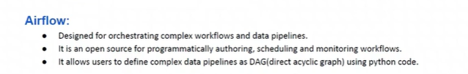
What is Airflow?
Apache Airflow is a platform used to programmatically author, schedule, and monitor workflows.

Slide 3
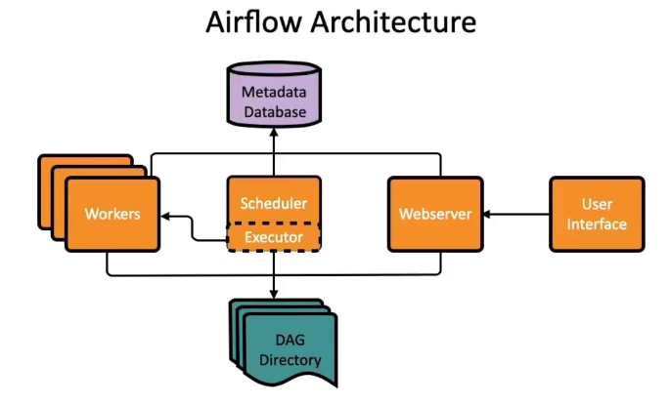
Airflow Architecture

Slide 4
Airflow Components
Executor:
The executor is responsible for actually running the tasks submitted by the scheduler. Airflow supports various executor types, such as LocalExecutor (for single-machine setups), CeleryExecutor, and KubernetesExecutor, which distribute task execution to worker nodes.
Web Server:
The web server provides the Airflow UI, a graphical interface that allows users to monitor DAG runs, view task statuses, inspect logs, trigger DAGs manually, and manage connections and variables.
Metadata Database:
This database stores all the critical information about Airflow's state, including DAG definitions, task instances, execution logs, connections, variables, and more. It serves as the central repository for all Airflow components to interact and maintain state.
DAG Files:
These are Python files that define the Directed Acyclic Graphs (DAGs), which represent the workflows. They specify the tasks, their dependencies, and the scheduling information.
Worker (Optional):
In distributed setups, workers are separate processes or containers that execute tasks assigned by the executor. They are particularly relevant when using executors like CeleryExecutor or KubernetesExecutor.

Slide 5
Airflow Components
Tasks and Task Instances:
Each DAG consists of tasks, which are the individual units of work. A task in Airflow is defined by an operator, which determines the nature of the work to be performed. For example, a task might execute a Python function, run a bash command, or send an email.
Operators
Operators define the specific action that each task performs. Airflow comes with a rich set of built-in operators that you can use to execute a variety of tasks. Some of the common operators include:
PythonOperator: Executes Python functions.
BashOperator: Runs bash commands or scripts.
EmailOperator: Sends emails.
DummyOperator: A no-op operator that is useful for defining task dependencies.
MySqlOperator: Executes SQL commands on a MySQL database.
PostgresOperator: Executes SQL commands on a PostgreSQL database.

Slide 6
How to Create First DAG in Airflow?

Slide 7
Directed Acyclic Graph (DAG)
Directed Acyclic Graph (DAG) is a group of all individual tasks that we run in an ordered fashion. In other words, we can say that a DAG is a data pipeline in airflow. In a DAG:
There is no loop
Edges are directed
Key Terminologies:
Operator: The task in your DAG is called an operator. In airflow, the nodes of the DAG can be called an operator
Dependencies: The specified relationships between your operators are known as dependencies. In airflow, the directed edges of the DAG can be called dependencies.
Tasks: Tasks are units of work in Airflow. Each task can be an operator, a sensor, or a hook.
Task Instances: It is a run of a task at a point in time. These are runnable entities. Task Instances belong to a DagRun.
A Dag file is a python file that specifies the structure as well as the code of the DAG.

Slide 8
Steps To Create an Airflow DAG
Importing the right modules for your DAG
Create default arguments for the DAG
Creating a DAG Object
Creating tasks
Setting up dependencies for the DAG

Slide 9
Step 1: Importing the right modules for your DAG
The first and most important module to import is the "DAG" module from the airflow package that will initiate the DAG object for us.
Then, we can import the modules related to the date and time.
After that we can import the operators, we will be using in our DAG file.
Here, we will be just importing the Dummy Operator.
# To initiate the DAG Object
from airflow import DAG
# Importing datetime and timedelta
modules for scheduling the DAGs
from datetime import timedelta, datetime
# Importing operators
from airflow.operators.dummy_operator
import DummyOperator

Slide 10
Step 2: Create default arguments for the DAG
Default arguments is a dictionary that we pass to airflow object, it contains the metadata of the DAG.
We can easily apply these arguments to as many operators, that we want.
# Initiating the default_args
default_args = {
'owner' : 'airflow',
'start_date' : datetime(2022, 11, 12)
}
the owner can be the owner of the DAG
start_date is the date DAG starts getting scheduled

Slide 11
Step 3: Creating DAG Object
After the default_args, we have to create a DAG object, by passing a unique identifier, that we call "dag_id", Here we can name it DAG-1.
# Creating DAG Object
dag = DAG(dag_id='DAG-1',
default_args=default_args,
schedule_interval='@once',
catchup=False
)
dag_id is the unique identifier for the DAG.
schedule_interval is the time, how frequently our DAG will be triggered. It can be once, hourly, daily, weekly, monthly, or yearly. None means that we do not want to schedule our DAG and can trigger it manually.
catchup - If we want to start executing the task from the current task, then we have to specify the catchup to be False. By default, catchup is True, which means that airflow will start running the tasks for all past intervals up to the current interval by default.

Slide 12
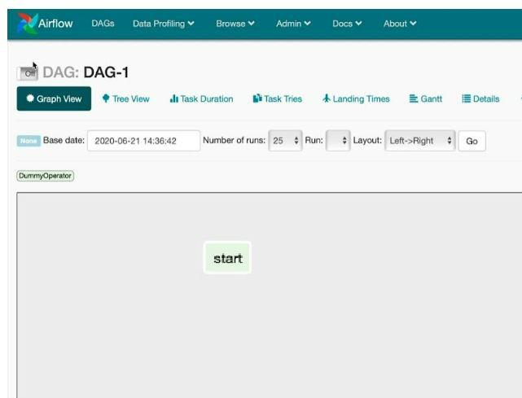
Step 4: Create tasks
A task is an instance of an operator. It has a unique identifier called task_id. There are various operators, but here, we will be using the DummyOperator.
# Creating first task
start = DummyOperator(task_id
= 'start', dag = dag)

Slide 13
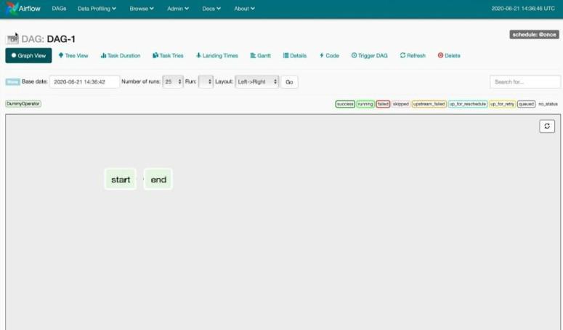
# Creating second task
end = DummyOperator(task_id
= 'end', dag = dag)

Slide 14
Step 5: Setting up dependencies for the DAG.
Dependencies are the relationship between the operators or the order in which the tasks in a DAG will be executed. We can set the order of execution by using the bitwise left or right operators to specify the downstream or upstream fashion respectively.
a >> b means that first, a will run, and then b will run. It can also be written as a.set_downstream(b).
a << b means that first, b will run which will be followed by a. It can also be written as a.set_upstream(b).
Dependencies are the relationship between the operators or the order in which the tasks in a DAG will be executed. We can set the order of execution by using the bitwise left or right operators to specify the downstream or upstream fashion respectively.
a >> b means that first, a will run, and then b will run. It can also be written as a.set_downstream(b).
a << b means that first, b will run which will be followed by a. It can also be written as a.set_upstream(b).
# Setting up dependencies
start >> end
# We can also write it as start.set_downstream(end)

Slide 15
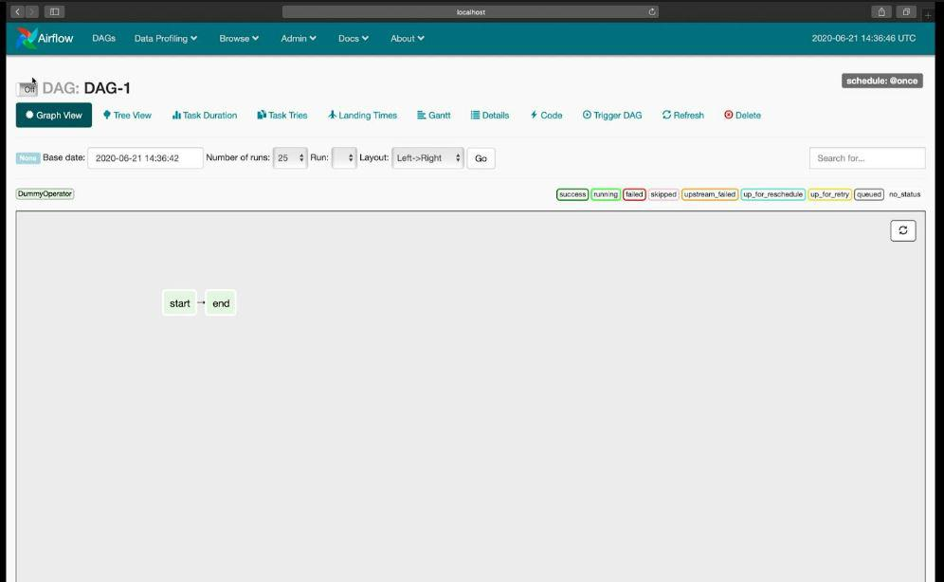

Slide 16
# Step 1: Importing Modules
# To initiate the DAG Object
from airflow import DAG
# Importing datetime and timedelta modules for scheduling the DAGs
from datetime import timedelta, datetime
# Importing operators
from airflow.operators.dummy_operator import DummyOperator
# Step 2: Initiating the default_args
default_args = {
'owner' : 'airflow',
'start_date' : datetime(2022, 11, 12),
}

Slide 17
# Step 3: Creating DAG Object
dag = DAG(dag_id='DAG-1',
default_args=default_args,
schedule_interval='@once',
catchup=False
)
# Step 4: Creating task
# Creating first task
start = DummyOperator(task_id = 'start', dag = dag)
# Creating second task
end = DummyOperator(task_id = 'end', dag = dag)
# Step 5: Setting up dependencies
start >> end

Slide 18
Databricks Airflow Integration
Databricks Airflow Provider (Recommended)
1.Install in MWAA:
pip install apache-airflow-providers-databricks
2. Then use DatabricksRunNowOperator or DatabricksSubmitRunOperator in your DAG.

Slide 19
from airflow import DAG
from airflow.providers.databricks.operators.databricks import DatabricksSubmitRunOperator
from datetime import datetime
default_args = {
'owner': 'airflow',
'depends_on_past': False,
'retries': 1,
}
with DAG(
dag_id='databricks_job_dag',
start_date=datetime(2023, 1, 1),
schedule_interval='@daily',
default_args=default_args,
catchup=False,
) as dag:

Slide 20
# Task: Submit a Databricks job
submit_run = DatabricksSubmitRunOperator(
task_id='submit_spark_job',
json={
'new_cluster': {
'spark_version': '13.3.x-scala2.12',
'node_type_id': 'i3.xlarge',
'num_workers': 2,
},
'notebook_task': {
'notebook_path': '/Repos/etl_pipeline/transform',
},
},
databricks_conn_id='databricks_default', # Defined in Airflow Connections
)

Slide 21
In Airflow UI → Admin → Connections, configure:
Conn Id: databricks_default
Conn Type: Databricks
Host: https://<databricks-instance>.cloud.databricks.com
Token: (Databricks PAT or AAD token)

Slide 22
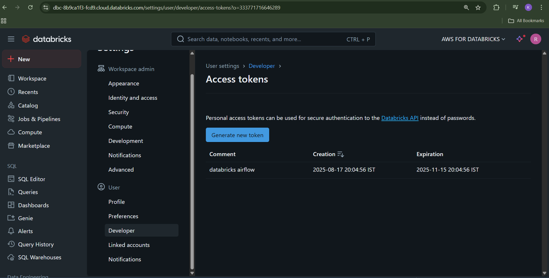
How to generate PAT

